Slide 1
A Comparison of Cyclistic Bikes
Marc Gutierrez
Email: marcgutierrez16@gmail.com
Linkedin: www.linkedin.com/in/marcgutierrez98
Github: https://github.com/marcgutierrez98

Slide 2
Business Task
How do annual members and casual riders use Cyclistic bikes differently?
In order to answer this question we will,
Identify trends for annual members
Identify trends for casual riders
Compare them and outline key differences

Slide 3
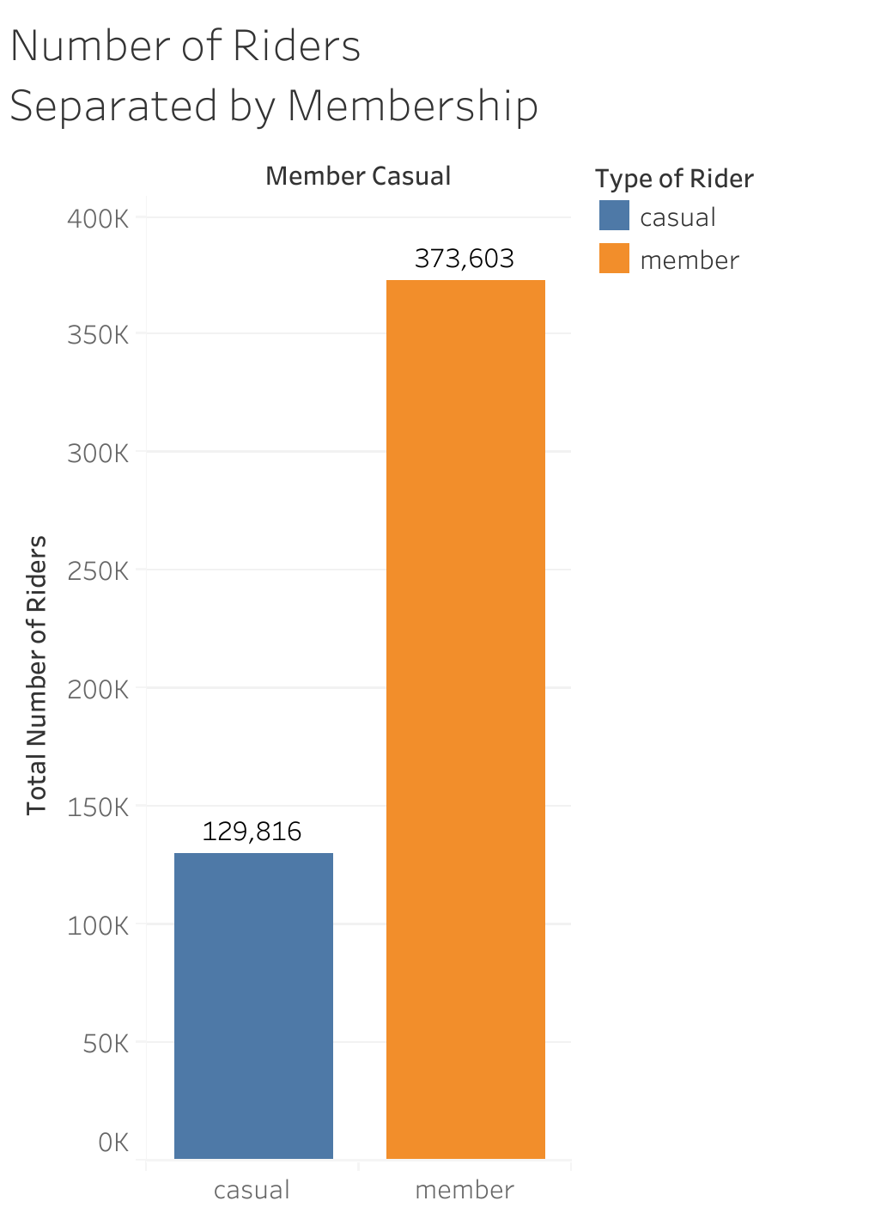
General Overview of Cyclistic Bikes Customer Base
There are two types of customers for Cyclistic Bikes; annual members and casual riders.
Total Members: 373,603
Total Casual Riders: 129,816
Grand Total: 503,419

Slide 4
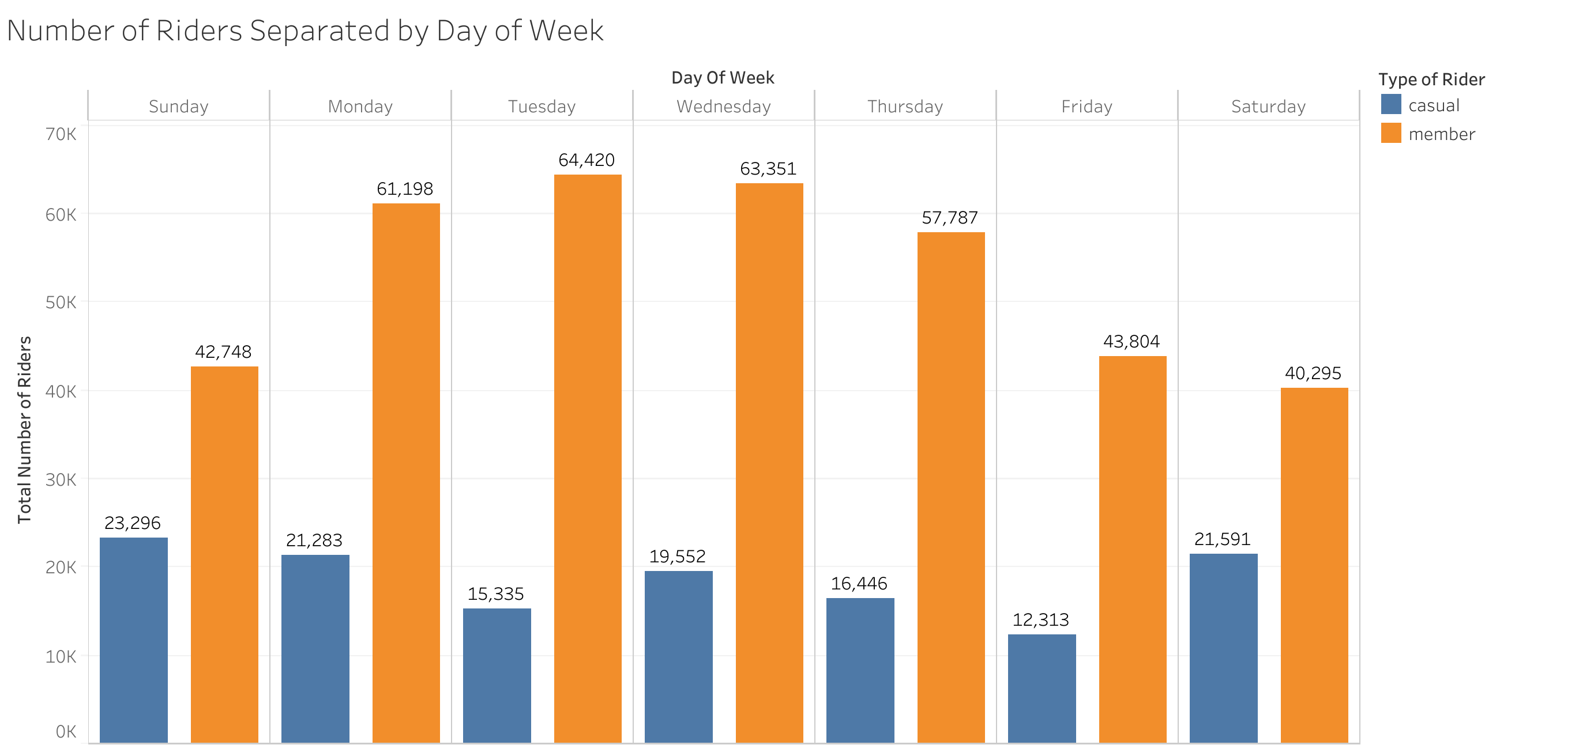
Weekly Overview of Cyclistic Bike Riders
For Members
Monday, Tuesday, and Wednesday were the most popular day
For Casual Riders
Saturday and Sunday were the most popular

Slide 5
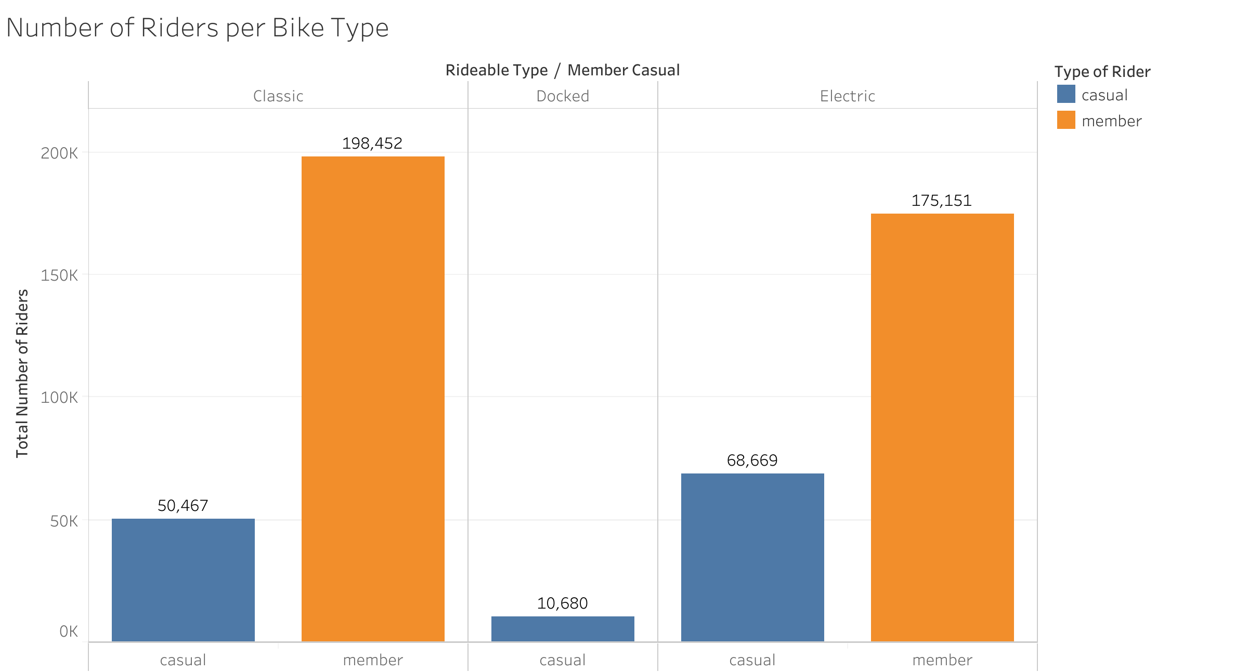
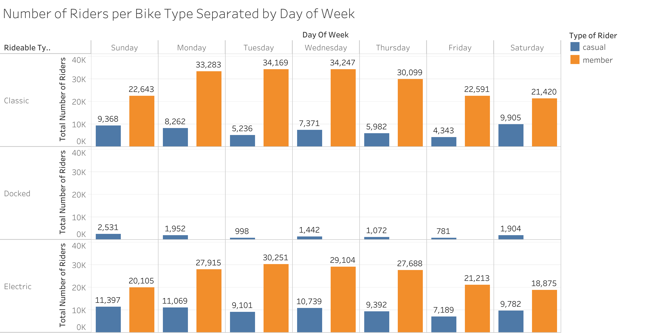
Usage of Bikes Between Bike Riders
Docked bikes were only used by casual riders and had the least amount of use.
Both classic and electric bikes were more favored by both types of riders.

Slide 6
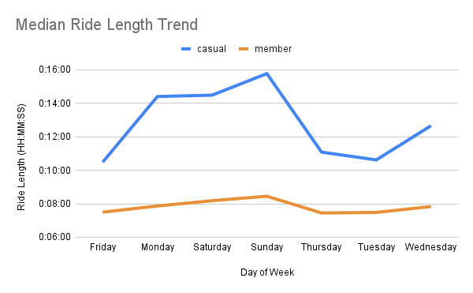
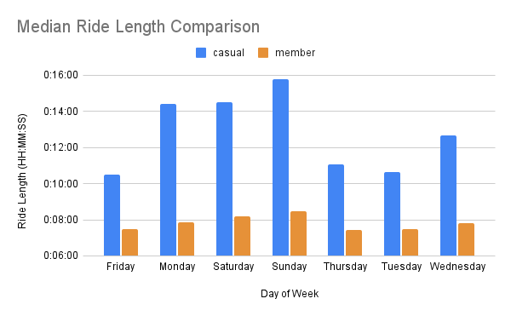
Median Ride Length Between Riders
Overall the median ride length was greater for members than it was for casual riders.
The lowest median ride length for members would be on Friday, meanwhile the lowest median ride length for casual riders would be on Thursday.

Slide 7
Summary and Recommendations
Overall Summary
Recommendations
Docked bikes were only used by casual riders and had the least amount of use. Both classic and electric bikes were more favored by both types of riders.
Monday, Tuesday, and Wednesday were the most popular day for members.
Saturday and Sunday were the most popular for casual riders.
Friday was the least popular day for both members and casual riders.
Overall the median ride length was greater for members than it was for casual riders.
The lowest median for members would be on Friday, meanwhile the lowest median for casual riders would be on Thursday.
Being able to reward riders for using certain bikes (preferably docked bikes) can lead to casual riders that enjoy using these bikes into becoming annual members.
We noticed that casual riders enjoy using Cyclistic bikes on the weekend more, thus the company can offer an incentive for weekend riders.

Slide 8
Conclusion
Data is first party and was taken from a certified company “Lyft Bikes and Scooters, LLC.”
Licensing can be found here https://ride.divvybikes.com/data-license-agreement
Data can be found here https://divvy-tripdata.s3.amazonaws.com/index.html
Anomalies to Consider
There were instances of several rides that would last days or maybe a week, which then skewed some of the data.
Therefore, some of the analysis was taken using the median ride length rather than the total sum or the average ride length.

